Slide 1
Mobile Robot
Path Drift Estimation using Visual Streams
Helio Perroni Filho
Notes:
Hello everyone, I'm Helio Perroni Filho and this is my presentation on Path Drift Estimation for Mobile Robots using Visual Streams.

Slide 2

Teach-Replay
Teaching a robot to move along a route
Example: office courier robot
Notes:
Currently there is great interest in more intuitive man-machine interfaces for robotics systems, especially robots that can be configured by example, rather than direct programming.
In the context of route planning, this is called teach-replay. For example, let's say we have an office courier robot to carry documents or supplies from one room to another. How can it be taught the routes it should follow?

Slide 3
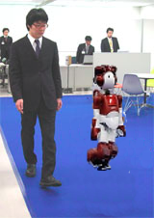
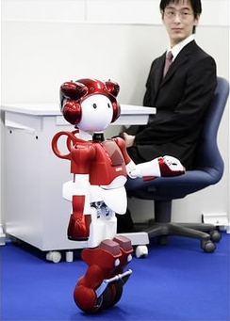
Teach-Replay
Robot is guided along a path
Notes:
If our robot can do teach-replay, first we guide it through the route (what we call the “teach step”)...

Slide 4
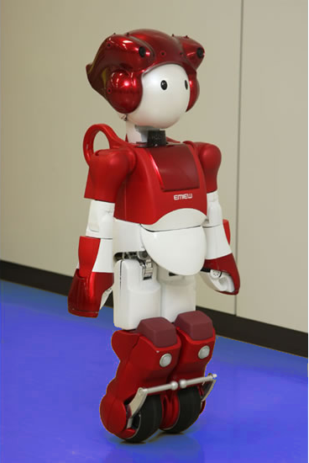
Teach-Replay
Robot retraces guided path autonomously
Notes:
And later, using information gathered along the route, the robot will retrace it autonomously (the “replay step”).

Slide 5
Teach-Replay
Naive implementation: odometry
(x0, y0, θ0)
(xn, yn, θn)
Notes:
We could think of implementing this on odometry. Surely, if the robot can reliably locate itself relative to a global reference frame, then it could simply record its movements during the teach step, and repeat them on the replay step.

Slide 6
Teach-Replay
Problem: runaway odometry drift
(x', y', θ')
(x, y, θ)
(Δx, Δy, Δθ)
Notes:
Unfortunately, any intrinsic localization system is subject to the progressive accumulation of reading errors, such that after a while there is a large difference between where the robot thinks it is...
… and where it actually is.
This difference is what we call drift.
How do we account for that?

Slide 7
Topics
Teach-Replay
Appearance-based Navigation
Differential Visual Streams (DiVS)
Drift Estimation
Experiments
Conclusion
Further Research
Notes:
This is the subject of the remainder of this presentation.
First I will define appearance-based navigation, which is one way to implement teach-replay over visual data. Then I describe an image processing method I call Differential Visual Streams (or DiVS for short), and show how it can used to implement a drift estimator.
Next I show the results of a number of experiments made with the drift estimator, discuss what conclusions can be drawn from those results, and finally discuss directions for further research.

Slide 8
Appearance-based Navigation
Solution: localization through landmarks
Ir
It
f(It, Ir) ≈ (Δx, Δy, Δθ)
Notes:
The essence of appearance-based navigation is that, given some distinct visual feature of the environment, that is, a landmark...
If I have a picture of this landmark, taken from the position where the robot should be...
I can take another picture of this same landmark from the robot's current location...
And then use some method to estimate differences in location from the differences in landmark appearance between the two pictures.
Then I can use this estimated difference to drive the robot towards its objective.

Slide 9
Appearance-based Navigation
Record image streams (continuous sequences)
I'5
I'3
I'4
I'1
I'2
I1
I2
I3
I4
I5
f(It, Ir) ≈ (Δx, Δy, Δθ)
It = {I1, I2, ..., It}
Ir = {I'1, I'2, ..., I't}
Notes:
In practice, we record image streams, that is sequences of images for the teach step and the current replay step. The whole sequences can then be used to infer the current location from a history of successive appearance differences.

Slide 10
Appearance-based Navigation
Recognize landmarks across images
Compare landmark sightings
Respond to perceived changes in landmark location
Notes:
It is said technology never solves a problem without creating other two. Here we create three.
In order to implement appearance-based navigation, we need a way to recognize landmarks across images, even against changes in visual conditions...
Having recognized a landmark, we need to define how to compare its different sightings...
And finally, how the robot is to respond to changes in landmark appearance.

Slide 11
Topics
Teach-Replay
Appearance-based Navigation
Differential Visual Streams (DiVS)
Drift Estimation
Experiments
Conclusion
Further Research
Notes:
Let's turn to the first problem, how to recognize landmarks across images.

Slide 12
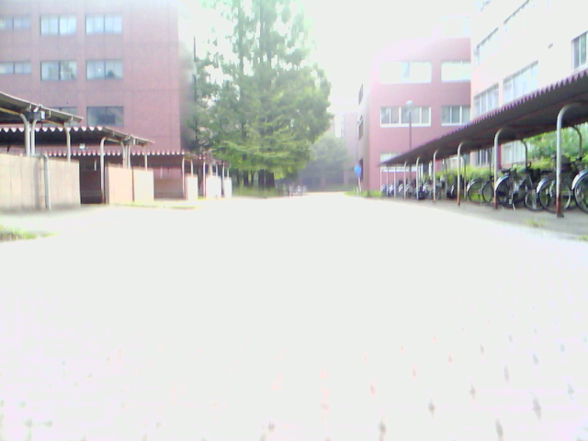
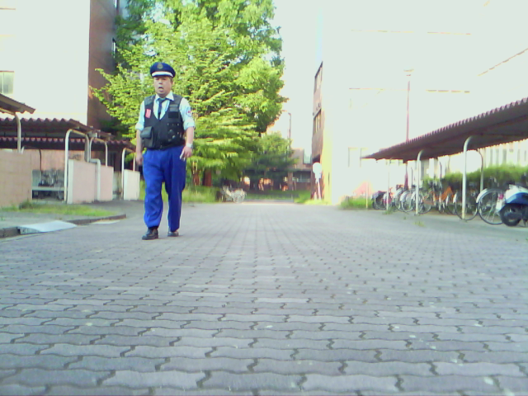
Differential Visual Streams (DiVS)
How to recognize landmarks across changes in lighting, point-of-view, occlusions, etc?
Need to find and/or compute invariants
Notes:
The main problem with appearance-based navigation is that image data is notoriously inconsistent across visual conditions. Differences in lighting, point-of-view and occlusions can completely change how a landscape looks.
Therefore we need to find invariants, features that are consistent across environmental variations.
But finding invariants between individual images can become very difficult, if visual conditions are too different.

Slide 13
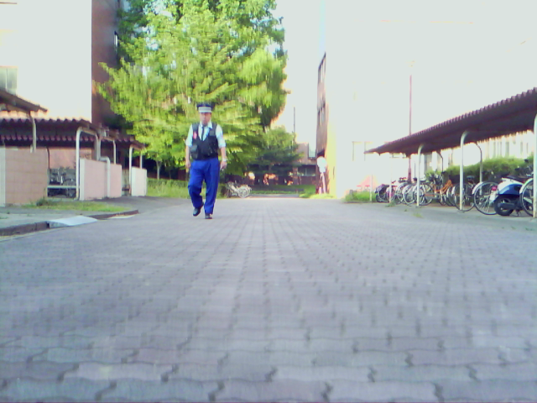
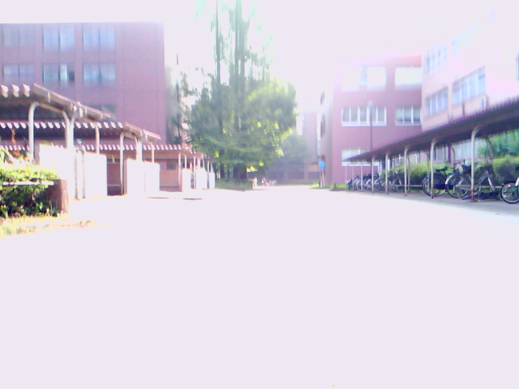
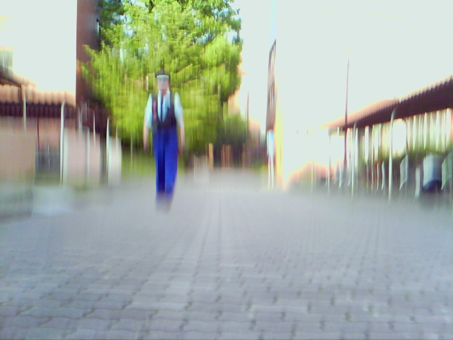
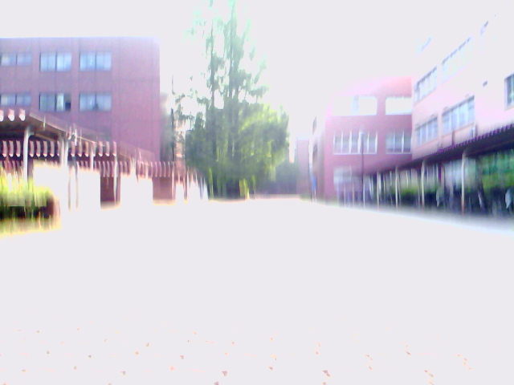
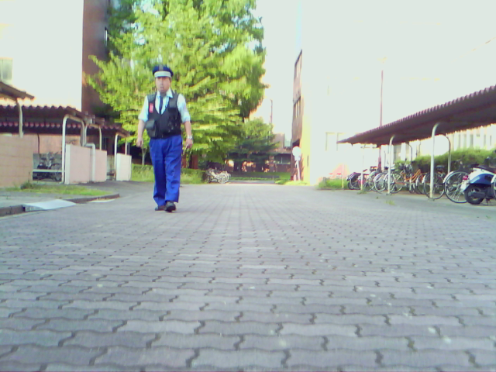
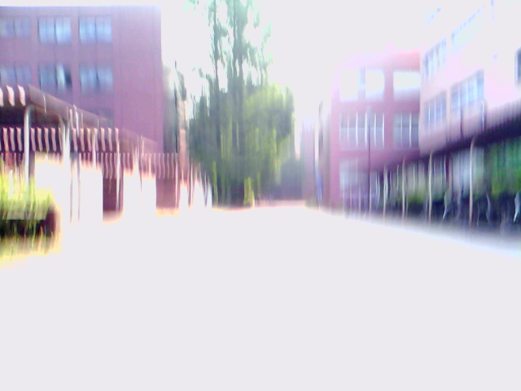
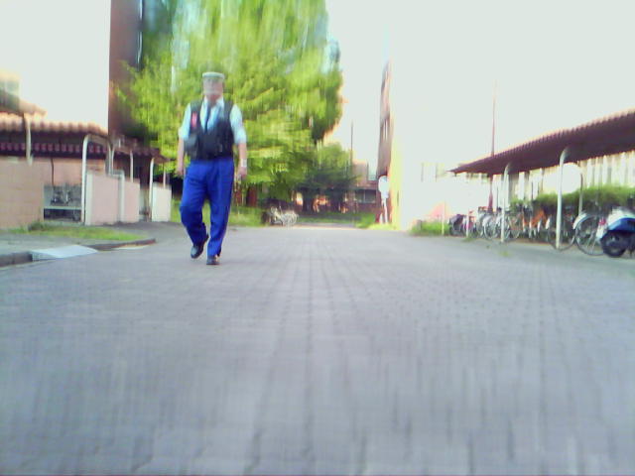
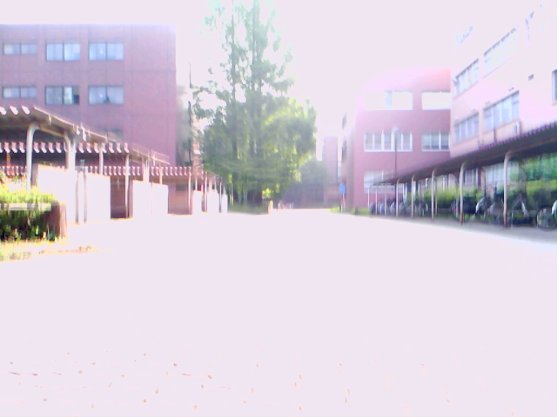
Differential Visual Streams (DiVS)
Look for invariants between image sequences, rather than individual images
Do image sequences change in similar ways?
Notes:
So instead of looking into individual images, we look into whole sequences for invariants.
Our expectation is that differences among images in one sequence will be in some way equivalent to the differences among images in another sequence recorded at the same landscape, even if visual conditions are very different.

Slide 14
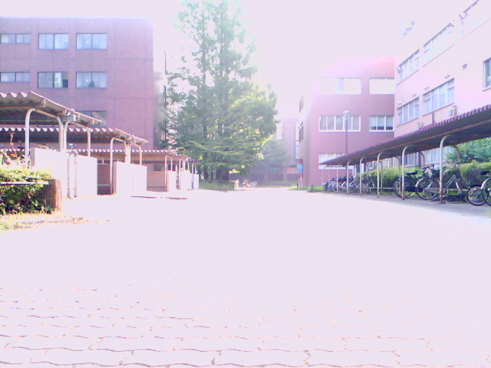
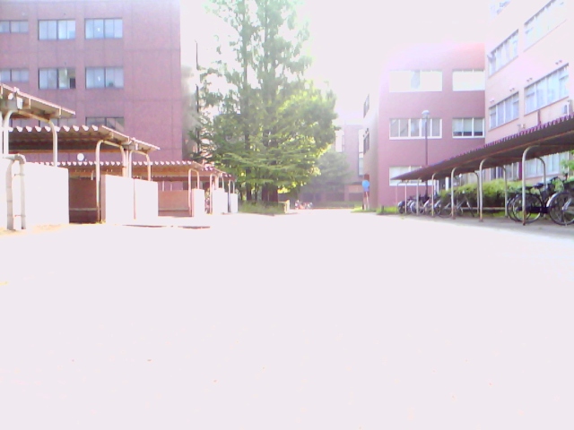
Differential Visual Streams (DiVS)
Images change as the landscape is approached
I0
I1
Notes:
So let's look into image sequences and see how it changes as an observer approaches the landscape in front of it.
Here, for example, we have to images from a same sequence, I-0 and I-1.

Slide 15
Differential Visual Streams (DiVS)
Objects move towards borders as they are passed by
Objects look bigger as they draw closer
I0
I1
Notes:
We can notice that landscape objects move towards the borders of the visual field as they are passed by.
They also seem to grow bigger as they draw closer.

Slide 16
Differential Visual Streams (DiVS)
Closer objects change more than far-off ones
I0
I1
Notes:
Also, far-off objects change less than closer ones. As we can see the image of the tree almost didn't move, while closer objects moved by comparatively large amounts.

Slide 17
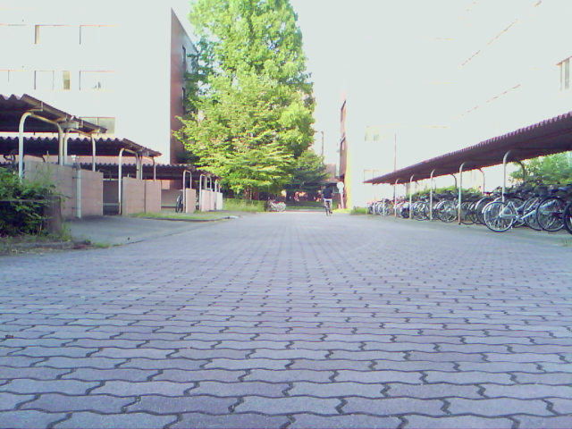
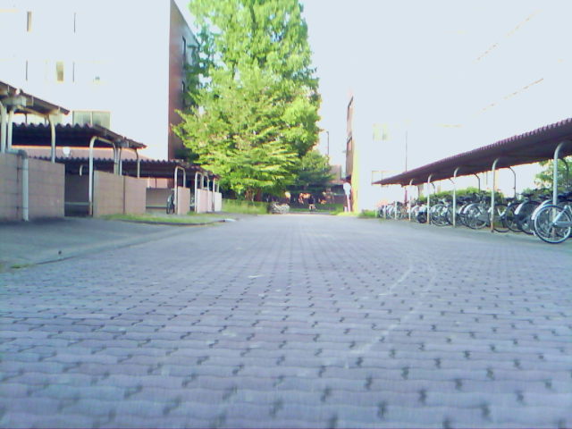
Differential Visual Streams (DiVS)
Changes are consistent across visual conditions
Changes themselves can be used as invariants
I'0
I'1
Notes:
And if we look at images I-prime-0 and I-prime-1 from a different sequence, recorded in the same landscape under different visual conditions, we notice the same dynamics hold.

Slide 18
Differential Visual Streams (DiVS)
Changes are consistent across visual conditions
Changes themselves can be used as invariants
I0 | I1
I'0 | I'1
Notes:
Therefore we can assert that when comparing image sequences, what objects are recorded is not so important; rather, the way the contents of the visual field change across the sequence can itself be used to characterize a landscape.

Slide 19
Differential Visual Streams (DiVS)
Difference images can show the changes between frames
I0
I1
Notes:
But how to represent change between images on a sequence?
One way is to use difference images.

Slide 20
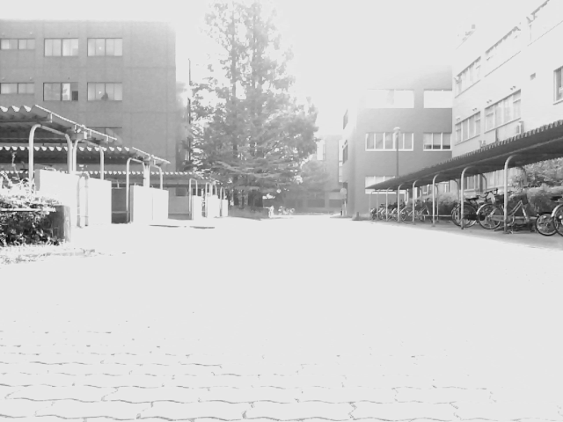
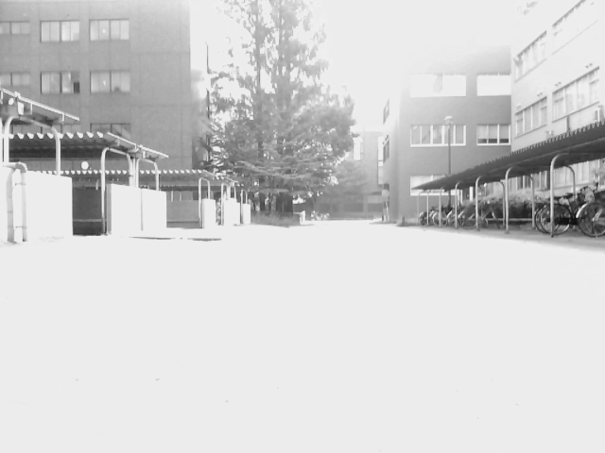
Differential Visual Streams (DiVS)
Difference images can show the changes between frames
Gray(I0)
Gray(I1)
Notes:
If we take two images, convert them to gray scale...

Slide 21
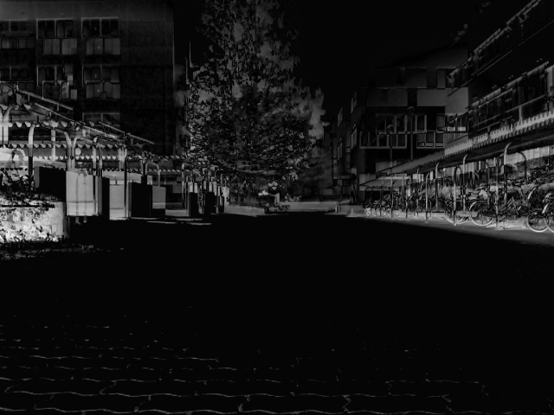
Differential Visual Streams (DiVS)
Difference images can show the changes between frames
D1 = |Gray(I0) - Gray(I1)|
Notes:
...and then perform the pixel-by-pixel absolute difference between the two images, the darker regions in the resulting difference image show where the two images are very similar to each other, and the brighter regions, where they are different.

Slide 22
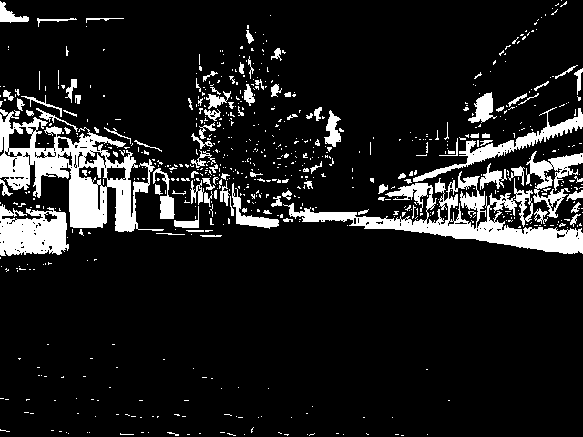
Differential Visual Streams (DiVS)
Thresholded difference images show high change regions
B1 = OTSU(D1)
Notes:
We can apply a thresholding operation, such as Otsu's method, to provide a clear separation between “change” and “no change” regions.

Slide 23
Differential Visual Streams (DiVS)
Thresholded difference images are largely invariant to lighting changes
I0 , I1
I'0 , I'1
Notes:
If we apply this sequence of operations to two image pairs, recorded under different visual conditions...

Slide 24
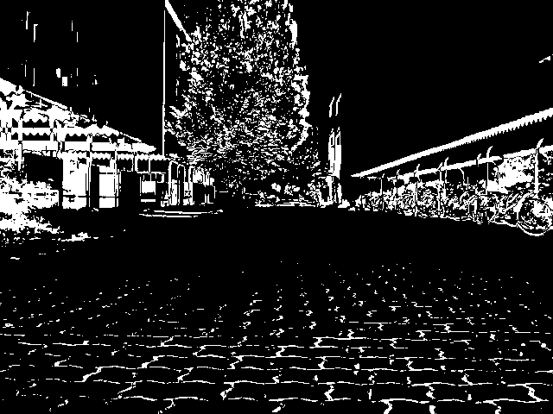
Differential Visual Streams (DiVS)
Thresholded difference images are largely invariant to lighting conditions
B1 = OTSU(D1)
B'1 = OTSU(D'1)
Notes:
...we notice the resulting thresholded difference images are very similar to each other, despite the large differences in the original images.

Slide 25
Differential Visual Streams (DiVS)
Moving elements can produce large differences in otherwise similar sequences
I0 , I1
I'0 , I'1
Notes:
Unfortunately, this representation does not account for moving elements. In this case, otherwise similar image pairs...

Slide 26
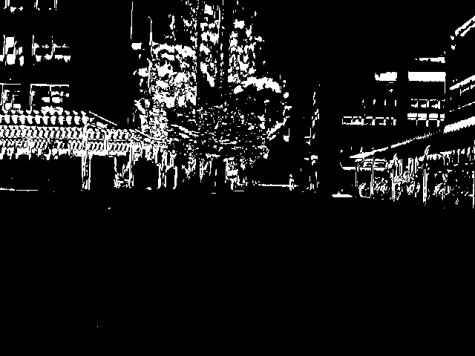
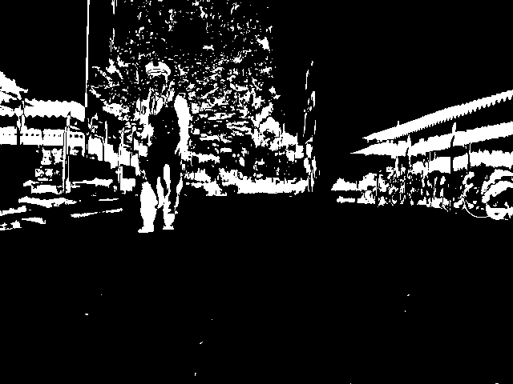
Differential Visual Streams (DiVS)
Moving elements can produce large differences in otherwise similar sequences
B1 = OTSU(D1)
B'1 = OTSU(D'1)
Notes:
...can display sharp variations in their thresholded difference images, due to the presence of moving elements such as people.

Slide 27
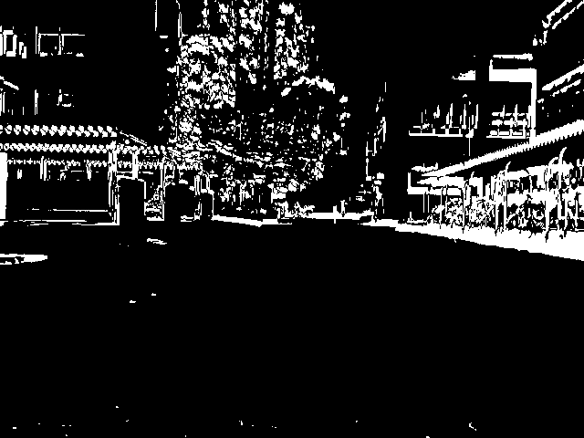
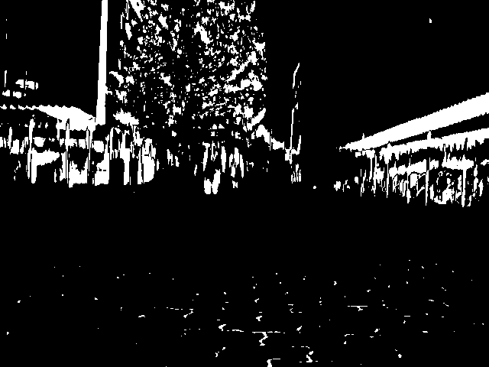
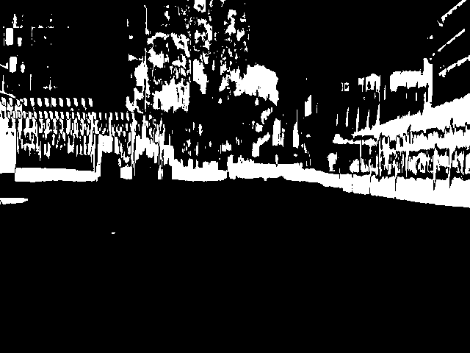
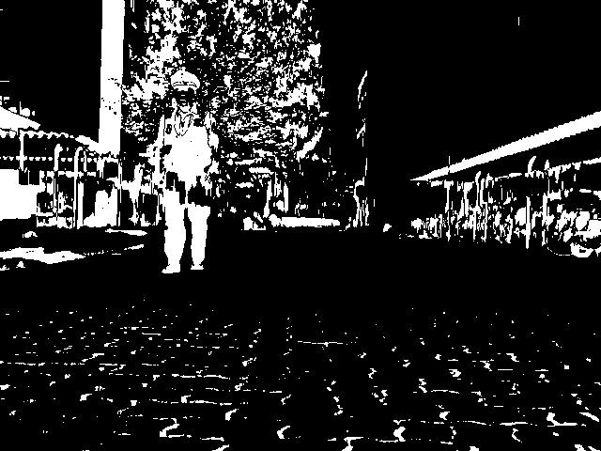
Differential Visual Streams (DiVS)
Transient deviations can be smoothed out by averaging a sequence of thresholded images
...
...
B1 , B2 ... , B25
B'1 , B'2 ... , B'25
Notes:
However, if we smooth out such transient changes by calculating the average over a sequence of difference images...

Slide 28
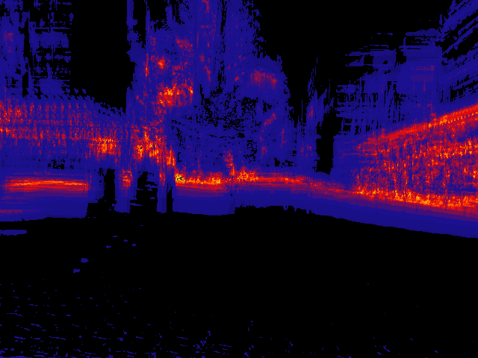
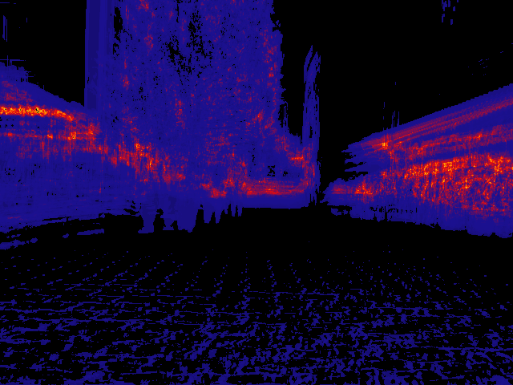
Differential Visual Streams (DiVS)
Sharp deviations can be smoothed out by averaging a sequence of thresholded images
Notes:
...the resulting representation is much more stable, even in the face of such variations.
These are what I call differential images, they show the amount of change in different regions of the visual field over a sequence window of some size w. Brighter colors show high amounts of change, and darker colors, low amounts.

Slide 29
Differential Visual Streams (DiVS)
I =
I0
I1
I2
...
Iw-1
Iw
Iw+1
...
It-w
...
It
B =
B1
B2
...
B
Bw
B
...
B
...
Bt
w-1
w+1
t-w
DiVS =
∂w
∂
...
∂
...
∂t
w+1
t-w
Notes:
Let's do a quick recap on the process so far:
Starting from an image sequence, or stream...
We calculate pair-wise, thresholded difference images...
And then average those binary images over a window of some size w.
The sequence of images calculated according to this procedure is what I call a Differential Visual Stream, or DiVS.

Slide 30
Differential Visual Streams (DiVS)
Notes:
This can also be expressed mathematically: given a window of size w, the “index k” DiVS image is computed as the averaged sum of the w thresholded gray-scale difference images, from index w - k up to index k.

Slide 31
Topics
Teach-Replay
Appearance-based Navigation
Differential Visual Streams (DiVS)
Drift Estimation
Experiments
Conclusion
Further Research
Notes:
So DiVS provides a representation that is robust to changes in lighting, occlusion and moving elements. How can it be leveraged to implement appearance-based navigation?

Slide 32
Drift Estimation
Robot drift is accompanied by shift in landmark images
Ik
I'k
Notes:
First we need to know how changes in observer location are related to visual input.
Given a robot in a very simple environment with a single landmark, if they are perfectly aligned...
The landmark's image will fall on the center of the robot's visual field. Whereas if the robot is drifting to the right...
The landmark's image will fall on the left side of its visual field.
This relation between physical drift and image shift can be explored to enable robot localization.

Slide 33
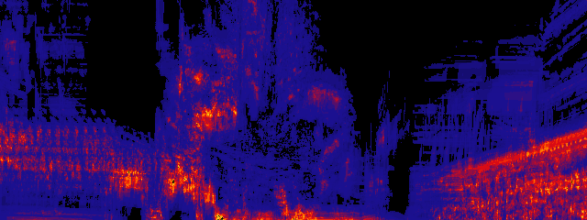
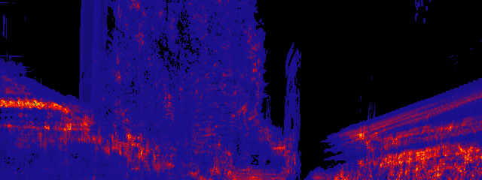
Drift Estimation
DiVS images can be compared for shift
teach
replay
∂k
∂'k
Notes:
DiVS images can be compared for shift. In this example we compare a DiVS image from a teach step to another from a replay step.
First, notice that the bottom half of DiVS images is usually of poor recognition value. Because it mostly pictures the ground, it is either largely empty, or filled with noisy patterns such as those left by floor tiles.
Therefore, before trying to compare DiVS images, we do always with their lower halves, keeping only the upper halves for comparison.

Slide 34
Drift Estimation
DiVS images can be compared for shift
teach
replay
Notes:
Then we slide the teach step half-image over the replay one, computing a measure of match quality as we go.
The position of best match indicates the shift between teach and replay DiVS images. As you can see from the plot the shift, which is measured in pixels, can be either negative or positive. Negative shifts indicate drifts o the right, and positive shifts, drifts to the left.
Incidentally in this example the shift is negative, indicating a drift to the right.

Slide 35
Drift Estimation
Shifts over time indicate the robot's route relative to a reference
DiVS =
∂w
∂
...
∂
...
∂t
w+1
t-w
DiVS' =
∂'w
∂'
...
∂'
...
∂'t
w+1
t-w
Notes:
Given two DiVS image sequences, say from a teach path and a replay path, shifts can be computed for successive image pairs. Plotting these shifts over time, we produce an approximation of the robot's deviation from the teach path as it moves along the replay path.

Slide 36
Drift Estimation
Drift estimates are computed empirically from image shifts
Notes:
We still need to define how image shifts are translated to drift estimates.
Empirical tests suggest a linear relation to image shifts and drifts in distance from the original path and heading direction.
Pending better assessment, for now we convert image shifts to drift estimates merely by applying a cut-off limit, followed by an optional scaling factor.

Slide 37
Topics
Teach-Replay
Appearance-based Navigation
Differential Visual Streams (DiVS)
Drift Estimation
Experiments
Conclusion
Further Research
Notes:
How well does the method described so far work?

Slide 38
Experiments
Teach / Teach tests
  Compare two teach step records
  Check quality of computed image shifts
  Off-line
Teach / Replay tests
  Drive the robot using a teach step record
  Check quality of estimated drifts
  On-line
Notes:
Two types of tests were used to evaluate the performance of DiVS and the drift estimator:
In order to check if image shift values were consistent across different amounts of drift and visual conditions, several teach steps were recorded and compared off-line.
Then, to test the drift estimator, a control module was used to drive the robot, comparing a selected teach step record with the robot's visual input in real-time.

Slide 39
Experiments
Teach / Teach tests
Reference record
Test records
10°
5°
2°
0°
-2°
-5°
-10°
Early morning 07/24 07:30~
No moving elements
Late afternoon 07/30 16:15~
Occasional moving elements
(pedestrians, cyclists)
Notes:
For the teach / teach tests, the reference teach step was recorded in the morning, in the absence of any moving elements. The test records were recorded in the afternoon, and occasionally contain moving elements such as pedestrians or cyclists.
Six of the test records differed from the reference by an initial in-place turnof 2°, 5° or 10°, either to the left or to the right.

Slide 40
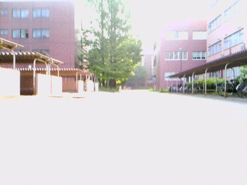
Experiments
Teach / Teach tests
Reference record
Notes:
The reference record is as shown here. As you can see there is a lot of vibration due to the uneven floor, as well as large saturated regions due to poor camera hardware.

Slide 41
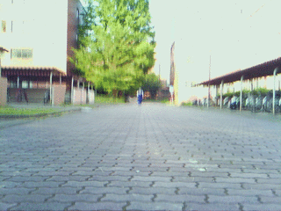
Experiments
Reference X test record 0°
Test record 0°
Notes:
The first test record includes a moving element: a campus officer walks towards the robot, eventually passing it by.

Slide 42
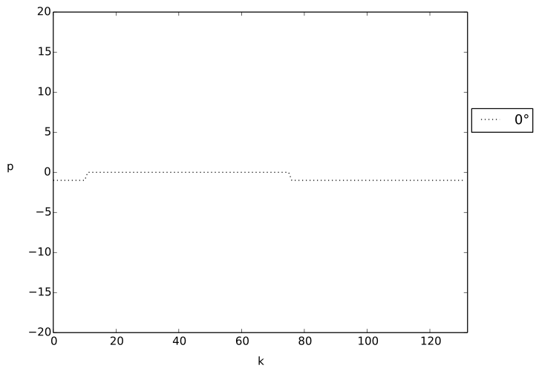
Experiments
Very good results: zero to negligible shift
Notes:
Despite this and the differences in visual conditions, the computed shifts are either zero or negligible, correctly indicating the robot is treading much the same path as in the reference record.

Slide 43
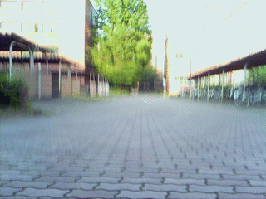
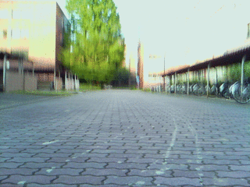
Experiments
Reference X test records 2° / -2°
Test record 2°
Test record -2°
Notes:
Next, two test paths diverging from the reference path by an initial 2° in-place turn, either to the left or to the right, were evaluated.
As you can see, in the left drift path there were some people passing the robot by, while the right drift path was largely devoid of any moving elements.

Slide 44
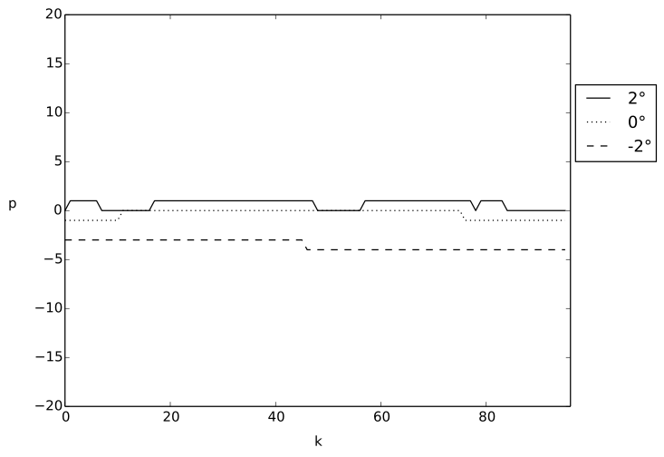
Experiments
Good results, but some inconsistencies
Notes:
Compared to the previous test this one didn't go quite so well – the shift reported for the left drift path is too low, and at times goes down to zero. On the bright side, shift direction is consistent with drift's, and the right drift path produced a much better response.

Slide 45
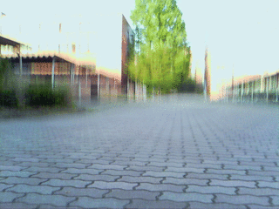
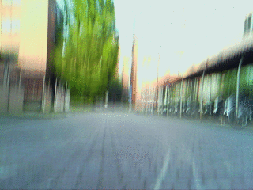
Experiments
Reference X test records 5° / -5°
Test record 5°
Test record -5°
Notes:
For initial in-place turns of 5° left and right, no moving elements in sight.

Slide 46
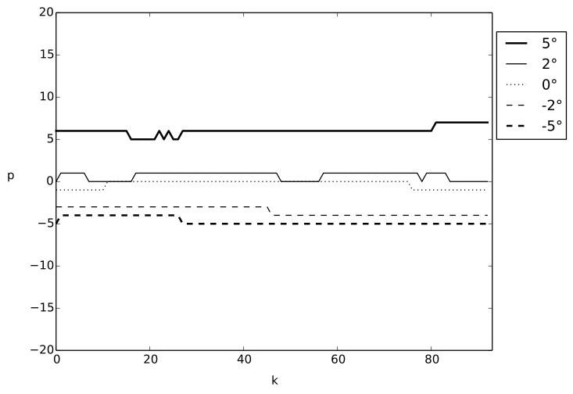
Experiments
Good results: right direction, shifts larger than for 2° / -2°
Notes:
Results were much better than for 2° drift, with very definite results, also numerically consistent with previous cases.

Slide 47
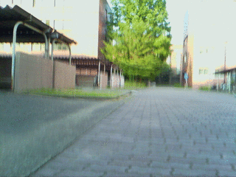
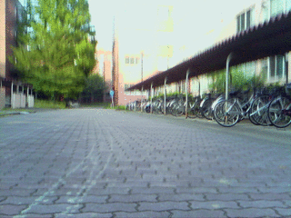
Experiments
Reference X test records 10° / -10°
Test record 10°
Test record -10°
Notes:
Finally for 10° drift, in the left case a cyclist passed by the robot coming from behind, and in the right case the environment is virtually deserted.

Slide 48
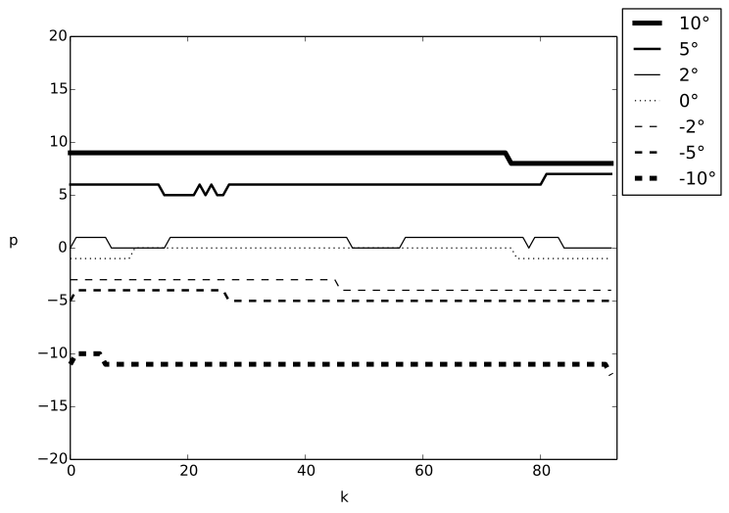
Experiments
Good results: right direction, shifts larger than for 5° / -5°
Notes:
Again it shows very good results, consistent with drift direction and numerical values of previous tests.

Slide 49
Experiments
Teach / Replay tests
Teach step
Replay steps
10°
5°
2°
-2°
0°
-5°
-10°
Early morning 07/24 07:30~
No moving elements
Early morning 07/24 07:30~
Occasional moving elements
(pedestrians, cyclists)
Notes:
Tests so far evaluated only the performance of image shift calculations. What about actual drift estimates? And what if the robot actually tries to correct its route in response to such estimates?
Teach / replay tests were performed to answer those questions. Given a teach step record – the same used as reference in the previous teach / teach tests – the robot is set off from the same start position, but with different initial in-place turns.
It records images as it goes, and as soon as it has enough to calculate a DiVS image, it computes shift between it and the corresponding teach DiVS image, steering in response to any non-zero shifts found.

Slide 50
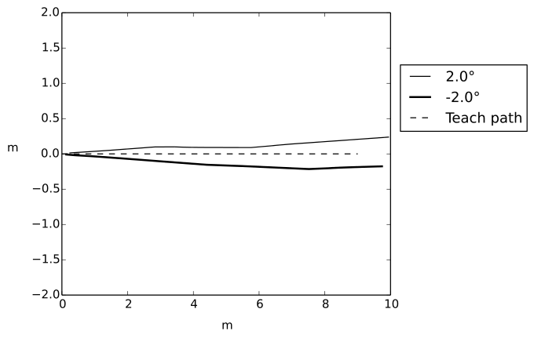
Experiments
Teach X replay steps 2° / -2°
Poor results: divergence / slow convergence to teach path
Notes:
This plot compares the teach step path with two replay paths, starting from initial in-place turns of 2° left and right.
The dashed line shows the teach path, which is a simple straight path. The solid line and the bold solid line represent the replay paths from 2° drift left and right respectively.
In the left drift case, after an initial route correction in the right direction, the robot settles in a path parallel to the teach step's, but eventually deviates from it. For the right drift case, it takes a long time to recognize the drift; it does start converging towards the teach path then, but too slowly.

Slide 51
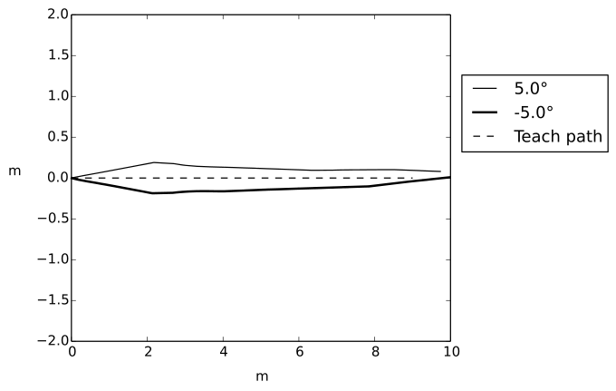
Experiments
Teach X replay steps 5° / -5°
Good results: steady convergence to teach path
Notes:
For 5° drifts, results were much better, with the robot eventually returning to the teach path.

Slide 52
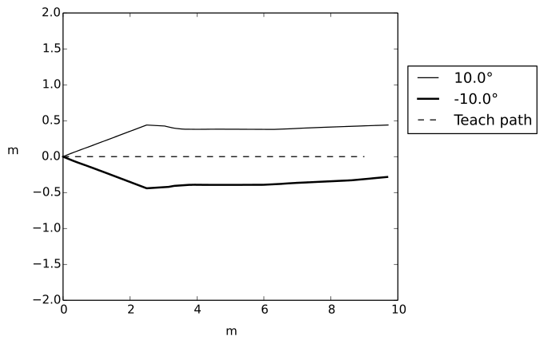
Experiments
Teach X replay steps 10° / -10°
Poor results: divergence / slow convergence to teach path
Notes:
For 10° drifts, however, the same results as for 2° drifts were found: the robot settles in a path parallel to the teach step's; then it may either deviate from it, or start converging, but very slowly.

Slide 53
Experiments
Problem: poor shift results when robot moves
parallel to teach path
Notes:
The main reason for these sub-optimal results is because differences in sideways position produce much less disparity in far-off landmarks, which compose the bulk of the landscape in many environments, especially outdoors. This results in much more subtle differences between DiVS images, and smaller, less definite shifts. So after an initial rout correction, if the robot happens to arrive at a path parallel to the teach step's, it becomes much harder to produce further route corrections from there.

Slide 54
Topics
Teach-Replay
Appearance-based Navigation
Differential Visual Streams (DiVS)
Drift Estimation
Experiments
Conclusions
Further Research

Slide 55
Conclusions
DiVS provides a visual representation robust to:
  Lighting changes
  Occlusion
  Moving Elements
DiVS image shift correlates well with route drift
  Direction of shift indicates direction of drift
  Shift amount correlates (linearly?) with drift distance
  Appearance-based navigation over DiVS is possible
Main weakness is sideways drift

Slide 56
Further Research
Sideways drift detection
Small turning drift detection
Further field tests
More elaborate paths
Control model

Slide 57
The End
Questions?
Notes:
This is the end of my presentation. Any questions?

